Slide 1
Protecting children on the Internet in Estonian Police
Anu Baum
Police and Border Guard Board
National Criminal Police

Slide 2
Police and Border Guard Board
Police and Border Guard Board (PBGB) was founded by merging Police Board, Central Criminal Police, Personal Protection and Law Enforcement Police, Border Guard Board, Aviation Group of Border Guard, and Citizenship and Migration Board
On the basis of the Police Prefectures and Border Guard Regions four territorial authorities were established: East Prefecture, West Prefecture, South Prefecture and North Prefecture
Common name of the organization is the Police
The biggest state authority in Estonia, 6 067 employees in total
The budget is ca 128 million euros

Slide 3
Service Areas of the Prefectures
Police and Border Guard Board is divided into four territorial units.
NORTH PREFECTURE
Area 10%
Inhabitants 39%
Crime rate 50%
EAST PREFECTURE
Area 16%
Inhabitants 18%
Crime rate 18%
SOUTH
PREFECTURE
Area 36%
Inhabitants 26%
Crime rate 21%
WEST
PREFECTURE
Area 38%
Inhabitants 17%
Crime rate 11%

Slide 4
Child protection units
In the criminal bureaus of the prefectures
Created January 1st, 2009
Number of employees:
North prefecture
East prefecture
West prefecture
South prefecture
National Criminal Police – coordinating and managing the work, trainings, equipment etc

Slide 5
Preliminary investigation
Led by the Prosecutor’s Office
Orders and decisions of the Prosecutor’s Office (including to start or not to start the proceeding) are obligatory for the police.
Prosecutors specialized on minors

Slide 6
Penal Code
According to the Estonian penal code, the following crimes against minors on the Internet are punishable:
§ 178. Manufacture of works involving child pornography or making child pornography available
§ 178¹. An agreement to meet with a child for sexual intentions
§ 179. Sexual enticement of children
§ 175. Human trafficking with the intention of abusing minors (Since June 1st, 2012)
Until June 1st of 2012 - § 177. Use of minors in manufacture of pornographic works and 177¹ use of minors in erotic works.

Slide 7
Statistics (01.01 – 19.09)

Slide 8
Trends visible in the statistics
Increase in sexual crimes against minors on the Internet.
Reasons:
- Internet enables access to many children at once
- Increase in police capability of discovering latent crimes (especially § 178)
- people’s increased trust for the police, increase in informing the police

Slide 9
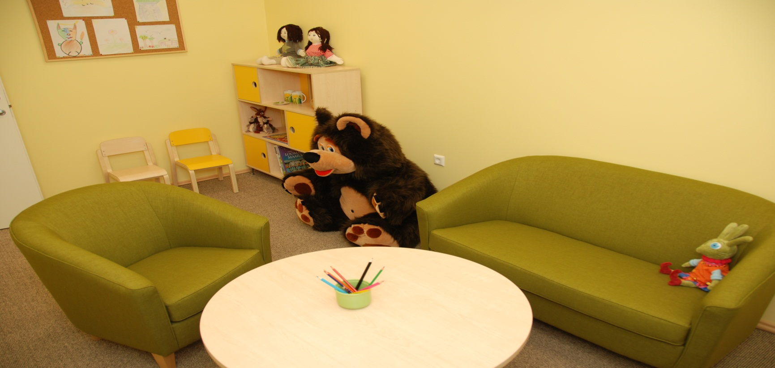
Criminal proceeding – child-friendly environment
Interrogating children only in special rooms with child-friendly decor.
Interrogation-rooms renovated in autumn 2011.

Slide 10
Criminal proceeding – procedure rules
Interrogations of minors are video-recorded.
If possible, the video-recording of the interrogation will be used in court.
Many cases find a solution in an agreement proceeding.
Negative: smaller/small punishment
Positive: child does not have to attend court
Premise for the agreement – the criminal admits full guilt.

Slide 11
Criminal procedure code § 70 – distinctions of interrogating minors
The investigator can invite a child protection official, social worker, pedagogue or psychologist to the interrogation of a minor. (Can, not must!)
if the investigator themselves does not have required training, the presence of a child protection official, social worker, pedagogue or a psychologist is obligatory if:
1) the witness is under 10 and repetitive interrogation can be harmful for the minor’s psyche
2) the witness is under 14 and the matters of the interrogation regard domestic violence or sexual abuse;
3) the witness has speech-, mind- or mental disorders.
The suspect has the right to get acquainted with the videorecording of the interrogation and ask the witness questions (in writing, application to the Prosecutor’s Office)

Slide 12
Cooperation inside the organization
Mostly with Central Criminal Police and regional cyber crime units:
- technical advice;
- help in searches
- monitoring up- and downloaders of child pornography on P2P networks (top 100 reports twice a month to child protection units)
Cooperation with expertise organization (Estonian Forensic Science Institute)

Slide 13
Cooperation – other organizations
Child protection officials and social workers of local municipalities:
- exchanging information;
- supporting interrogations;
Estonian Union for Child Welfare – managing Hotline
Investigation hints
Forwarding hints (INHOPE network)
Child help phone – forwarding messages
Victim aid services

Slide 14
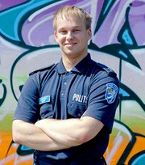
Prevention
Developing study materials for schools in the EE-SIC II project;
Visiting schools;
Informational materials for children and youngsters;
Virtual police station – so-called web-officers
http://www.facebook.com/#!/veebikonstaabel.andero
http://www.facebook.com/#!/pages/Veebikonstaabel-Maarja/291776857585370

Slide 15
Thanks
Questions?
Contacts:
anu.baum@politsei.ee

